Slide 1
Test Automation

Slide 2
Software Testing Challenges : Coping with development
Development time
Version 1.0
5000 days
Version 2.0
2500 days
Version 3.0
2000 days
Test time
Version 1.0
5000 days
Version 2.0 + 1.0 *
2500 + 2500 days
Version 3.0 + (2.0 + 1.0) *
2000+ 1250 + 2000 days
* Impact Analysis testing

Slide 3
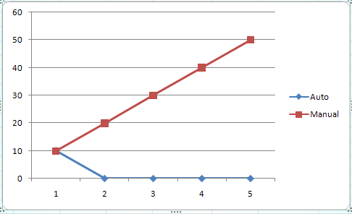
Automated Tests vs Manual Tests
Effort and Cost
  Lets assume 6 test cases
  Effort required to run all 6 manually => 10 min
  Effort required to write unit tests for all 6 cases => 10 min
  Effort required to run unit tests for all 6 cases => < 1 min
  Number of testing iterations => 5
  Total manual testing time => 50 min
  Total unit testing time => 10 min
Release | Manual Test | Auto Test | Manual Test Cumulative
1 | 10 | 10 | 10
2 | 10 | 0 | 20
3 | 10 | 0 | 30
4 | 10 | 0 | 40
5 | 10 | 0 | 50

Slide 4
Automated Tests vs Manual Tests
Effort and Cost
  Adding incremental Unit test cases is cheaper than adding incremental Manual Test Cases
    Eg: register Domain
      Case 1: Register a .com domain with all correct fields
      Case 2: Register a .com domain with an invalid name server

Slide 5
Automated Tests vs Manual Tests
Manual Testing is boring
  No one wants to keep filling the same forms
  There is nothing new to learn when one tests manually
  People tend to neglect running manual tests
  No one maintains a list of the tests required to be run if they are manual tests
Automated Tests on the other hand are code
  They are fun and challenging to write
  One has to carefully think of design for reusability and coverage
  They require analytical and reasoning skills
  They represent contribution that is usable in the future

Slide 6
Automated Tests vs Manual Tests
Manual Testing is not reusable
  The effort required is the same each time
  One cannot reuse a Manual Test
Automated Tests are completely reusable
  IMPORTANT: One needs to setup a Continuous Integration Server, a common Code Repository and a organization structure
  Once written the Automated Tests form a part of the codebase
  They can be reused without any additional effort for the lifetime of the Project

Slide 7
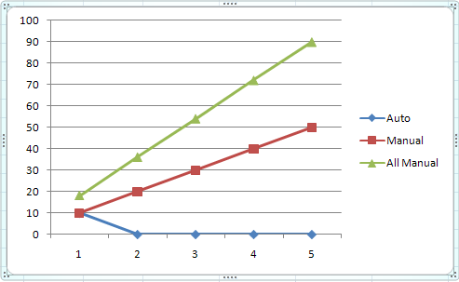
Automated Tests vs Manual Tests
Manual Tests provide limited Visibility and have to be Repeated by all Stakeholders
  Only the developer testing the code can see the results
  Tests have to be repeated by each stakeholder
    For eg Developer, Tech Lead, GM, Management
Automated Tests provide global visibility
  Developers, Tech Leads and Management can login and see Test Results
  No additional effort required by any of them to see the software works!!
Release | Manual Testing by Dev | Manual Testing by Team Leads | Manual Testing by Mgmt | Total Manual Testing | Auto Test | Dev Manual Test Cumulative | Total Manual Test Cumulative
1 | 10 | 5 | 3 | 18 | 10 | 10 | 18
2 | 10 | 5 | 3 | 18 | 0 | 20 | 36
3 | 10 | 5 | 3 | 18 | 0 | 30 | 54
4 | 10 | 5 | 3 | 18 | 0 | 40 | 72
5 | 10 | 5 | 3 | 18 | 0 | 50 | 90

Slide 8
Automated Tests vs Manual Tests
Manual Testing ends up being an Integration Test
  In a typical manual test it is very difficult to test a single unit
  In most circumstances you end up checking the unit along with backend services
  Introduces fragility – if something else breaks the manual test breaks
Automated Tests can have varying scopes
  One can test a unit (class / method), a module, a system etc

Slide 9
Automated Tests vs Manual Tests
Manual Testing requires complex Manual Setup and Tear Down
  Can involve frequently running db queries
  Can involve making changes to backend servers
  Steps become more complex with multiple dependent test cases
Automated Tests can have varying scopes and require less complex setup and teardown
  Unit Tests have external dependencies mocked – so no setup / teardown required
  Setup and Tear down are automated in Functional Tests using framework support

Slide 10
Automated Tests vs Manual Tests
Manual Testing has a high risk of missing out on something
  Each time a developer runs manual tests it is likely he will miss out on an important test case
  New developers may have no clue about the battery of tests to be run
Automated Tests have zero risk of missing out a pre-decided test
  Once a Test becomes a part of Continuous Integration – it will run without someone having to remember to run it

Slide 11
Automated Tests vs Manual Tests
Manual Tests have no training value
Automated Tests act as documentation
  Reading a set of Unit Tests clarifies the purpose of a codebase
  They provide a clear contract and define the requirement
  They provide visibility into different use cases and expected results
  A new developer can understand a piece of code much more by looking at Unit Tests than by looking at the code
  Unit Tests define the expected behavior of the code

Slide 12
Summary
Manual Tests take more Effort and Cost more than Automated Test to write and run
Manual Testing is boring
Automated Tests are reusable
Manual Tests provide limited Visibility and have to be Repeated by all Stakeholders
Automated Tests can have varying scopes and can test single units of code by Mocking the dependencies
Automated tests may require less complex setup and teardown

Slide 13
Summary
Automated Testing ensures you dont miss out on running a test
Automated Testing can actually enforce and drive clean design decisions
Automated Tests provide a Safety Net for refactoring
Automated Tests have Training value
Automated Tests do not create clutter in code/console/logs

Slide 14



Test Automation : Value Proposition
Reduction in testing costs
  Un-attended
  repeatability
  Less machines & Improved machine utilization
  QA engineers can focus on Kernel test activities
Shortened test lead times
  Manual test effort reduction
  Better Speed in executing tests
  Re-usable test ware
Monitoring ‘Quality’:Health of the product
  Insight about the risks Quickly
  Consistency across test runs
  Test frequently and thoroughly

Slide 15
Should I go for test automation.. It depends
Test effort levels
Test Process maturity
Organizational readiness
Quality of documentation
Quality of Test Documentation
Knowledge levels of test automation
Technical knowledge of the testing crew
Business risks involved in not doing regression testing
Stability, complexity and future plans of Application\Product

Slide 16
Test Automation Myths

Slide 17
Myth #1 - Test Automation is simple, that every tester can do it
This myth is promoted by the tool sales people. They are trying to promote the following test automation process:
  Record the script
  Enhance the script by adding functions and data driving
  Run the scripts
  Report results
Under the influence of this myth QA manager can proudly report: All our testers are developing test automation.

Slide 18
Reality - Test automation is a software development task
Automation should be designed, developed and tested
You need to have some kind of a programming background to implement test automation. Test Automation is not as complex as C++/C#/Java development.
Test automation standards should be developed
Automated test components are assets that should be treated like application source code

Slide 19
Myth #2 – Commercial test tools are expensive
Under the influence of this myth some companies, especially the small ones:
  Try to develop their own test automation tools
  Use scripting languages like Perl and Ruby
  Use shareware test tools
  Do not consider test automation at all

Slide 20
Reality – Commercial tools are cheap
Per seat license for most expensive automation tool is $8K
This tool will be used for 5 years.
Maintenance/Support fees are 20% of tool cost or $1,800 per year
The cost of this tool is $8K/5+$1,800 = $3,100 per year
The automation developer cost with overhead is $100K per year
The cost of this tool is just 3% of the person who uses it, but productivity gain can be very significant

Slide 21
Commercial Tool Benefits:
Customer support. Many of the open source tools come and go with little to no support
Most commercial tools are constantly being updated as technologies change
Most commercial tools usually have more functionality (QTP can test various GUI applications: Web, .Net, Java, VB, C/C++, PowerBuilder, etc. vs. WATIR – Web only)
Commercial tools usually have a large community of users, which translates into better availability of qualified resources
Commercial tools require less advanced programming
More test automation frameworks are available for commercial tools
Commercial tools are integrated with Test Management tools which makes reporting and execution much simpler.

Slide 22
Absolutely Unscientific research:
Employer demand by tool expertise
(May, 2008)

Slide 23
Dice search results across US (30 days)
Tool | Search string | Matches
QTP | Qtp OR quicktest OR "quick test“ | 613
Functional Tester | "rational robot" OR "functional tester” | 118
SilkTest | silktest OR "silk test” | 86
TestComplete | testcomplete OR "test complete” | 26
TestPartner | testpartner OR "test partner“ | 19
VSTE | VSTE AND test | 45
WATIR | watir | 26
Selenium | Selenium | 108

Slide 24
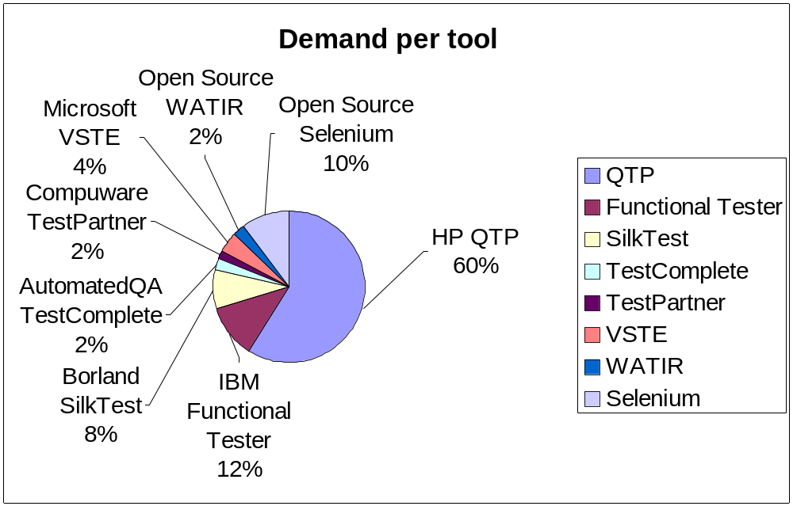

Slide 25
Excerpt from IDC Report:
“Worldwide Automated Software Quality 2007-2011 Forecast and 2006 Vendor Shares…”

Slide 26
